Slide 1
Survey
SKYPE SURVEY
Were you able to install jupyter notebook on your machine? Yes/No
How much experience do you have in python? (None, 0-1 year, 2-4years, expert)
What is your past experience with data science (none/little/main job)
SKYPE SURVEY

Slide 2



Logistic Regression
Brian, Halperin, Julie Buard
September 14, 2018

Slide 3


Introduction
Moderator:
Brian Halperin
Netsuite
North America
Speaker:
Julie Buard
Insights and Data
North America

Slide 4
Agenda
Topic approx. time
Introduction to Classification 5 min.
Data Science Workflow 5 min.
Exploratory Data Analytics 5 min.
Logistic Regression Model 5 min.
Cross Validation 5 min.
Grid-Search & Hyper-Parameter Optimization 5 min.
Model Performance and Evaluation 5 min.
Logistic Regression Code Overview 20 min.
Decision Trees and Random Forest 20 min.
Code Overview and Jupyter Notebook 10 min.
In the end you shall be a bit more familiar with Supervised Learning – foremost with Logistic Regression, Support Vector Machines, techniques measure & to tune your model’s performance.
Acknowledgements:
This material was first created for the 2017 German Connect and Learn Initiative
The presentation has been repurposed for Global Innovators Month by Brian Halperin and Julie Buard

Slide 5

Chapter 1: Introduction to Classification

Slide 6
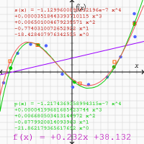
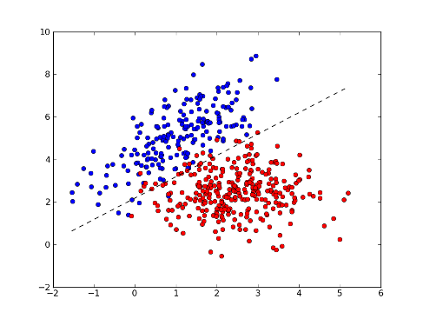
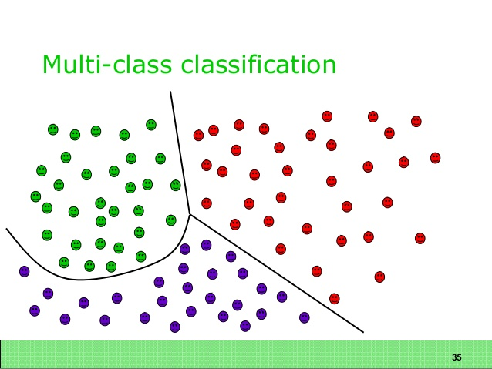
Classifier (Algorithm) vs. Regression (Data Model)
Binary
Classifier
Multi-class Classifier
Regression Assumptions

Slide 7
Classification in a Nutshell
Assigning Probable, Unknown Labels to Instances from its Features is Called Classification
Examples of classification in the real world:
Seeing pictures of men & women: assigning likely genders based on their physical appearances
Given pictures of various animals: estimating the more specific type of animal
Having a list of foreign family names: guessing what language each name comes from
Watching a movie: „guessing“ the genre from seeing it, from its cover or from the actor line-up
Scanning your mail: sorting desired ham messages from unsolicited spam – both for physical mail & for emails

Slide 8
Chapter 2: Data Science Workflow

Slide 9
Data Science Workflow from a Mile High Altitude
Data Engineering & Data Science Go Hand-in-Hand
70% to 90% of your time, an Explorative Data Analysis (EDA) help you understand your data
Obtaining & ingesting data
Basic to ever more complex Feature Engineering
Creating visuals, standardizing data, dropping or imputing missing values, etc. is a self-perpetuating loop leading to higher data quality and hence better model performance
Explorative Data Analysis
Model Building & Performance Tuning

Slide 10
Data Science Workflow from a Mile High Altitude
According to Pareto’s Principle, even Minor Portions may take the Majority of the Overall Time
Explorative Data Analysis
Model Building & Performance Tuning
Mostly probing cause/effect-relationships & Data Science tasks:
Split data into two/three perfectly partitioned parts – training, test data and validation data (the latter only in case no Cross-Validation is not used, as CV incorporates validation data as rolling windows in its training data)
Building some models
Optimize Features using e.g. Feature Scaling (Standardization), Feature Selection & more Feature Engineering
Tuning best models using Hyper Parameter Tuning like Cross-Validation & Grid Search
Possibly build Ensembles from different base models to improve overall robustness
Understand flaws in predictions through statistical measures such as Precision, Recall, ROC & AUROC
Estimating the final model‘s performance on test data
Visualizations almost only on meta data like classification errors (ground truth vs. predictions for specific subsets), performance measures, performance by Hyper Parameter set, performance convergence over time, etc.

Slide 11
Data Science Workflow from a Mile High Altitude
Always Start Getting Familiar w/ Your Data at Hand – most often by Visualizing it
Explorative Data Analysis
Model Building & Performance Tuning
Mostly understanding data & Data Engineering tasks:
Obtain data & ingest them in your data storage
Load data & convert attribute types to features and target columns
Handle anomalies like missing values, outliers and „falsely“ skewed distributions
Missing values may stay in place, be imputed or these instances can be omitted at all
Outliers may be dropped or weighted down
Skewed distributions, which may only be present in your data (sample), may be corrected or weighted to balanced impact during Model Performance assessment
Decide for first Secondary Data & Standardization means you deem helpful
Decide which features to drop up front: attributes not look worth trying to build even basic models from or you need to drop for e.g. legal reasons

Slide 12
Data Science Workflow from a Mile High Altitude
Op-ed: Your Opinion & Questions on the Former
Given that, what task suits you most?
EDA or everything else: to what set of tasks is there an end to and which one needs to be interrupted when the model performance looks sufficient?
Clearly the latter set of tasks depends on the former one (EDA); but is the opposite true as well?
Is there something after the second set of tasks?
Explorative Data Analysis
Model Building & Performance Tuning

Slide 13
Chapter 3: Exploratory Data Analysis

Slide 14
Refresher: Data Frames
Instances
Instances are rows from a data frame resp. table
Most models use data frames in denormalized form – usually „1st NF“ according to RDBMS‘ theory
Features
Features are attributes our model may use to determine a likely outcome – here a class
The outcome is called target
Empirical values of the target variable(s) to build our model are considered flawless
Values from the target variable to tune our model on validation data and to asses its final performance are also called ground truth
Likely outcomes for target from model candidates are called predictions
Relevant features are determined in feature selection based on the impact any attribute has on the target
Primary Features are attributes directly from the original, given data
Secondary Features are attributes derived from Primary data

Slide 15
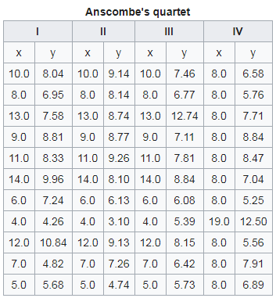
Data Example: Anscombe's Quartet
All Four Feature / Target Combination X, Y has Basically the same Statistical Properties
Source: https://en.wikipedia.org/wiki/Anscombe%27s_quartet

Slide 16
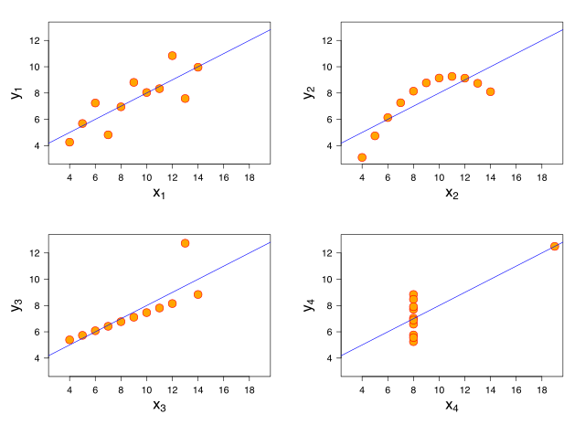
Data Visualization: Anscombe's Quartet
Visualization makes it way Easier to Apply Reasonable Models
Source: https://en.wikipedia.org/wiki/Anscombe%27s_quartet

Slide 17
Instances, Features & Target Variable in a Data Frame
As headers and column names are not part of your data frame‘s contents and usually abstracted by your tools, a Data Frame is a perfectly partitioned collection of values pertaining either Features or Target, which make entire instances in their combination.
Instances
Features
Target resp. Label

Slide 18
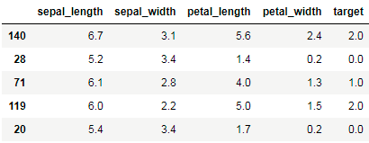
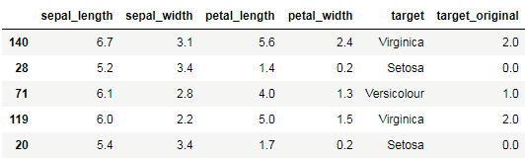
Performing EDA: Taking a Look at Our Features
Our Data is Composed of Four Features & One Target Attribute Before & Two After Feature Engineering

Slide 19
Refresher: Imputing Missing Data
There’s Basically Three Important Things You may do to Improve Your Data Quality
Omitting such instances
Imputing data with e.g. means of this feature
Generating models to generate reasonable data

Slide 20
Chapter 4: Logistic Regression Model

Slide 21
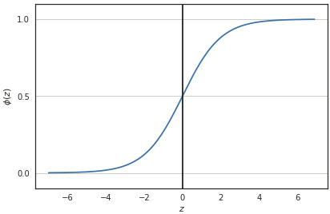
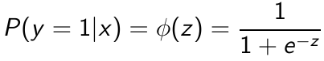
Sigmoid function as the secret ingredient to Logistic Regression
Sigmoid Function as a Strictly Monotonic Increasing Curve.
Scrams any Value from its Real-Valued Input-Space into its Target Space (0..1)

Slide 22
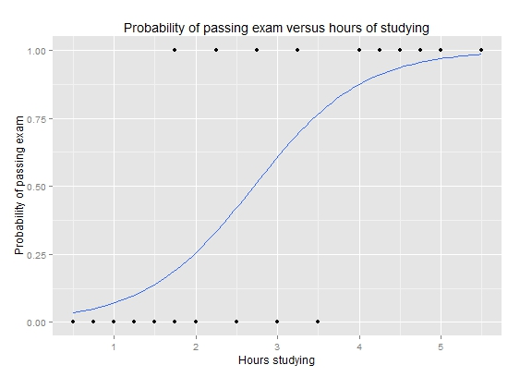
Applied Example of Sigmoid Function Usage
A Study Time Example to Predict Exam Passes
One Uni-Variate Variable in Both Classes: Pass & Fail
Think this plot being a 90 degree transposed version on another data set than the previous three-color plots. In this example, Logistic Regression will search a probability threshold in hours of studying for the Sigmoid Function to tell passes (1) apart from failures (0) on the abscissa.
Image courtesy: WikiMedia, Michaelg2015 user on Wikipedia.org, commons.wikimedia.org/wiki/File:Exam_pass_logistic_curve.jpeg

Slide 23
Chapter 5: Cross Validation

Slide 24
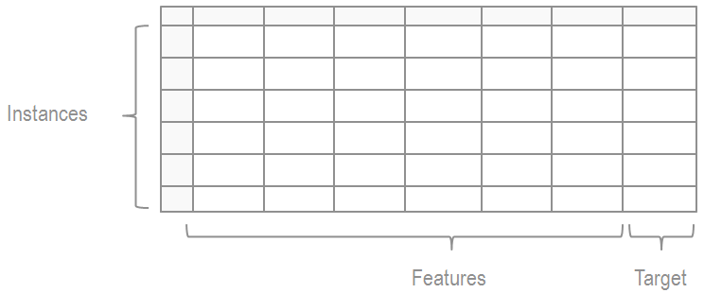
Upping the Game through Cross-Validation
Artificially Increasing Your Training Data Set Needs to be Done Carefully to not Over-Fit Your Model
Training and Test data should be perfectly partitioned to not loose any instances by splitting alone. Although, omitting instances with outlier values and missing data is fine and happened usually just beforehand.
The objective is
To have as big a Training data set as possible,
B) to have as big a Test data set as possible and
To have no overlapping instances – any row from e.g. a data frame shall belong to one subset only.
Entirety of Data Set Provided for Project
Training Data Set
Test Data Set

Slide 25
Upping the Game through Cross-Validation
Artificially Increasing Your Training Data Set Needs to be Done Carefully to not Over-Fit Your Model
Training Data Set
Test Data Set
Iteration
K=1
Train
Val
K=2
Train
Val
Train
K=3
Train
Val
Train
K=4
Val
Train
For K=1-Fold Cross-Validation, we get four times the iteration over our Training data set while having a 1/K part as a Validation data set in each iteration. The latter is used to tune the Model on, as the Training data is the only thing used in Model Building. The Validation data set is for this iteration an unseen data set to test optimizations on.
Why don‘t we use the Test data set for this purpose?

Slide 26
Upping the Game through Cross-Validation
Artificially Increasing Your Training Data Set Needs to be Done Carefully to not Over-Fit Your Model
Training Data Set
Test Data Set
Model Generation which may includes Optimization
Performance Evaluation
Final, Tuned Model
From our Training data set, with or without Cross-Validation other forms of Validation, results a Model. We assess its performance on an formerly unseen, separate Test data set.
Having Cross-Validation, Validation or other techniques of Optimization made through feedback from the Test data set, would lead to Data Leakage and indirectly exposing the Model to is. The Performance Evaluation in the end would yield a slightly better result there from. This Performance would not be achieved in production systems later on when this bias vanishes.

Slide 27
Chapter 6: Grid-Search & Hyper-Parameter Optimization

Slide 28
Hyper-Parameter Tuning & Grid Search
Best Practices for Hyper-Parameter Tuning and Search are Challenging to Provide w/o Concrete Cases
Hyper-Parameter C w/ factorial value list, e.g. (0, 1, 10, 100, 1000) by
Hyper-Parameter γ w/ factorial value list, e.g. (0, 0.1, 0.01, 0.001, 0.0001) –
One is a regularization penalty (C) for wrong predictions on Validation data and the other is to reduce Model Complexity (γ) to favor simpler, more robust Models
C: (0, 1, 10, 100, 1000)
γ: (0, 0.1, 0.01, 0.001, 0.0001)
For one Model to build, the Grid Search algorithm would need to check all possible combinations of categorical Hyper-Parameters – depicted in the above grid for a two Hyper-Parameter search space by all the 25 intersections within the grid and on its outer border (continuous parameters may be discretized for simplicity)
Any Model Generation step may include a K-Fold Cross-Validation within it as a Best Practice to make the Model more robust
For very large search spaces (number and/or cardinality of Hyper Parameters)
it may be a good idea to look for optima using exponentially scaled parameter values for each one
So you can find regions where there might be a best performing combination of parameters
Higher Learning Rates α usually yield faster Training times but may decrease your Model‘s performance due to skipped optima along the way – slower Learning Rates tend to train longer times w/ usually higher robustness

Slide 29

Hyper-Parameter Tuning & Grid Search
A Reasonable Grid for Three Evenly Value-Spread Hyper-Parameters might look like this: each Junction being a Model, the Space may be Reduced using Logarithmic Value Ranges for any Hyper-Parameter
image courtesy: pixabay.com/en/pyramid-graph-grid-grid-graph-1548355

Slide 30
Chapter 7: Model Performance
and Evaluation

Slide 31
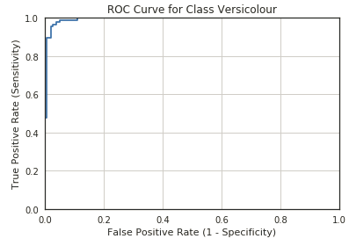
Receiver Operating Characteristics
Plotting False Positives against True Positives, where is a Likely Optimum in this Plot?
~ 0,03; 0,98
A ROC Curve shows for one model and its respective test data all possible class-breaking threshold values on the abscissa (False Positive Rate), against all True Positives on the ordinate. Hence the optimum is in the top-left corner at (0; 1). In general, the closest value towards this point is considered the best threshold for this class.
In this example, we‘d take about 3% percent False Positives and in return gain about 98% True Positives for it. The grey first major diagonal line is our baseline – the Model Performance for randomly guessing for Binary Classification. We need to be strictly better than this or invert our model if-need-be.

Slide 32
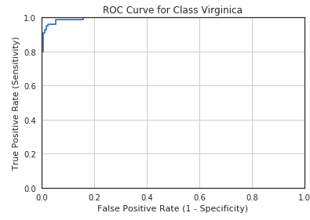
Receiver Operating Characteristics
ROC-Curves for Two iris Data Set Classes

Slide 33
Limitations & Cautionary Tales About ROC & AUROC
Be Aware what is Meant Referring to the AUROC Term
The AUROC score is no certain term – usually though, it is meant the area under the ROC Curve; be sure you talk about the very same thing when referring to AUROC
The ROC Curve does not take into account skews in class instances
Remind yourselves on the Data Science Challenge 3: unlike in iris, each class had a different count of class instances; hence a ROC Curve could fail you in tuning your model
To mitigate this problem, take the area/score for your Precision/Recall-Curve (or correct/incorrect classification costs) instead of ROC/AUROC – it will make sure biases are handled accordingly
ROC Curves & AUROC makes it easier to estimate misclassification costs but do not provide it right away – take for instance a medical test for rare disease: regardless of evidence, always predicting benign/healthy may yield prospectively accurate models, which is of no use at all

Slide 34
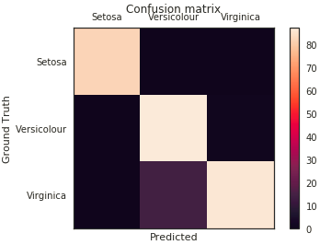
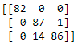
Multi-Class Confusion Matrix
Having Predicted Classes on Abscissa & Ground Truths on Ordinate, Misclassifications Become Clear
Raw table on left and colored Confusion Matrix on the right hand side.
What can you get from this particular Confusion Matrix?

Slide 35
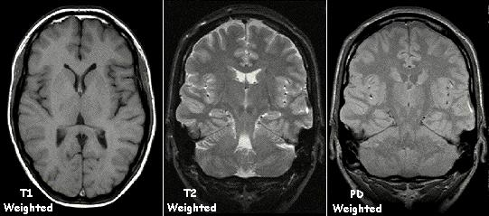
Costs of Misclassification
Vary Heavily Based on Industry and Use Case
image courtesy: https://commons.wikimedia.org/wiki/File:T1t2PD.jpg

Slide 36
Chapter 8: Logistic Regression
Code Walkthrough

Slide 37
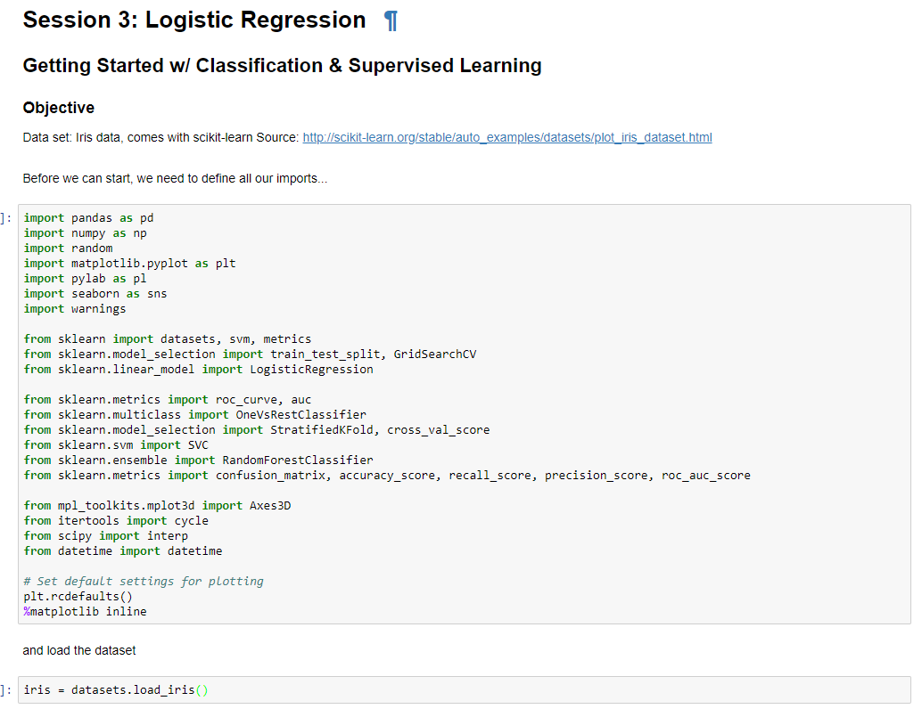
Code Review

Slide 38
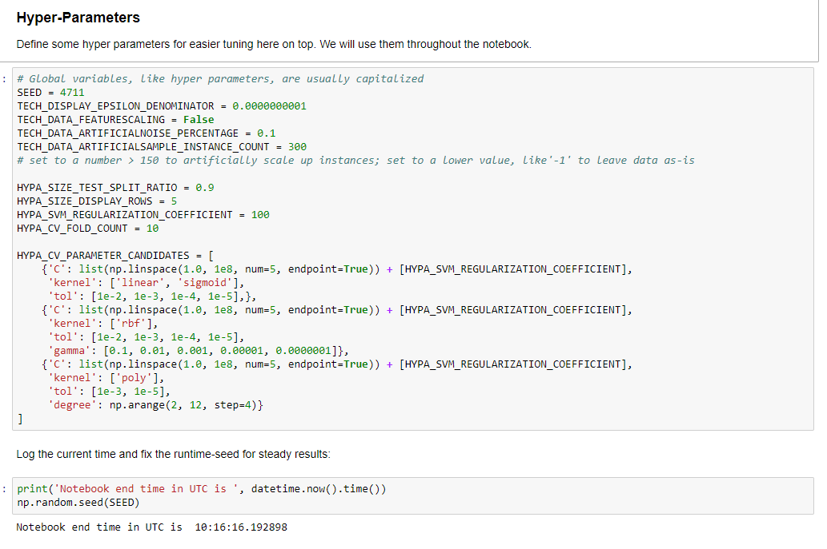
Code Review

Slide 39
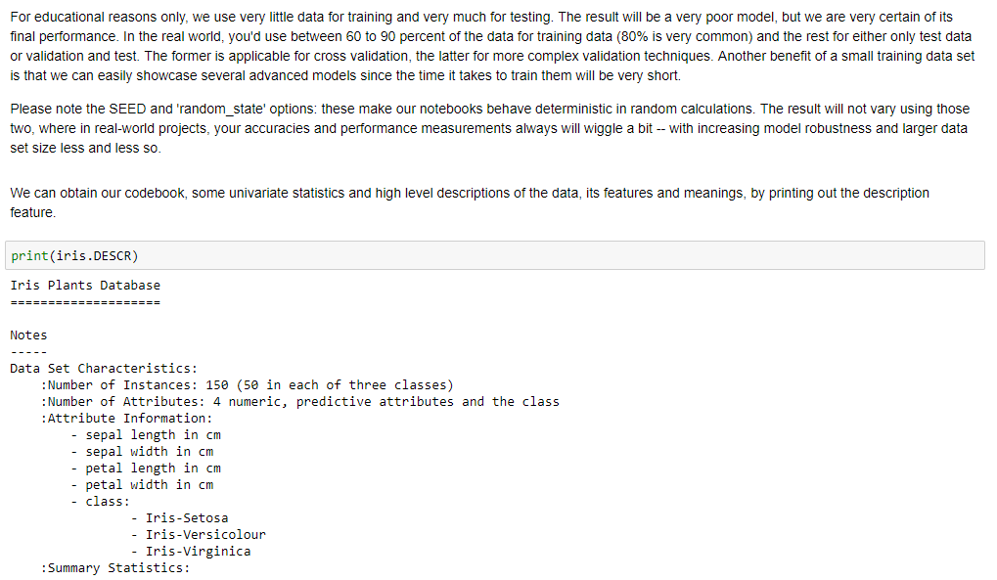
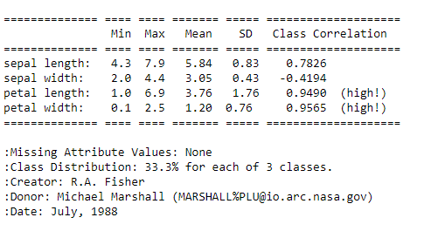
Code Review

Slide 40
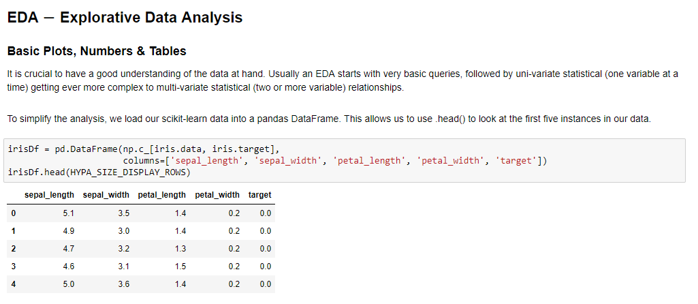
Code Review

Slide 41
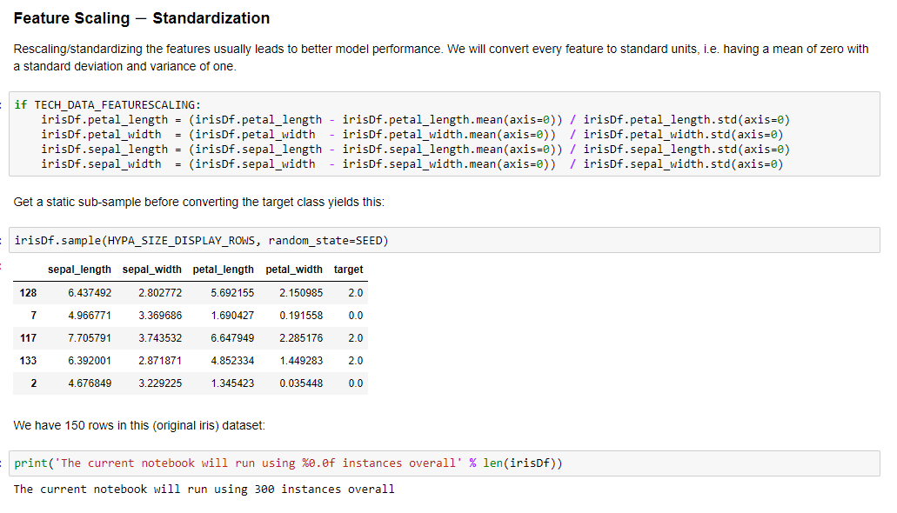
Code Review

Slide 42
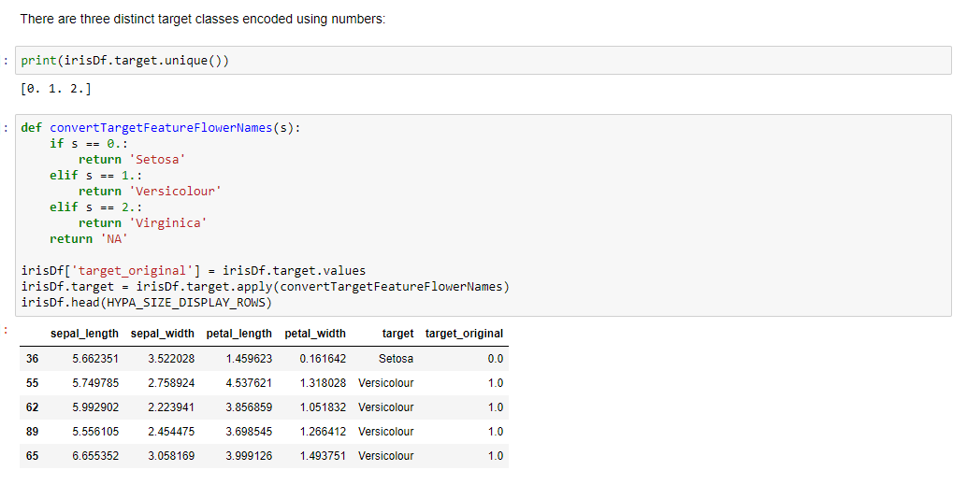
Code Review

Slide 43
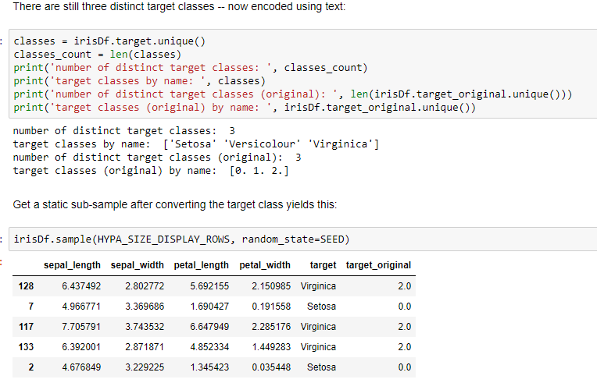
Code Review

Slide 44
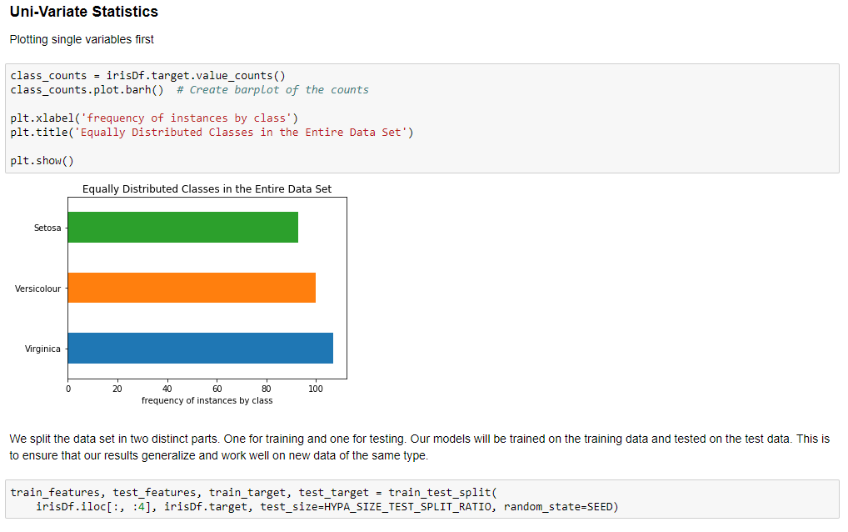
Code Review

Slide 45
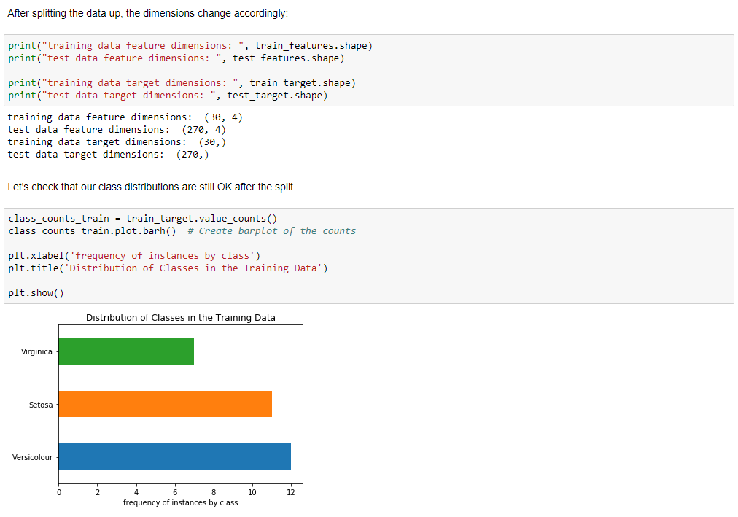
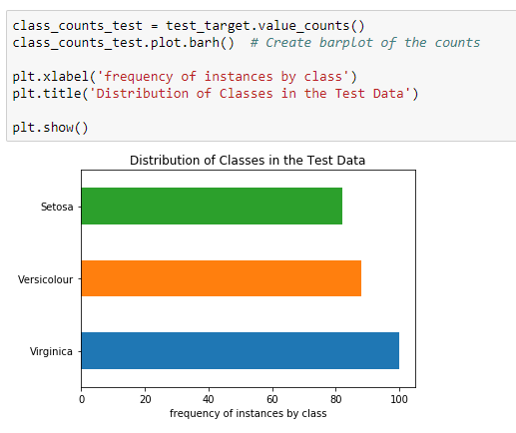
Code Review

Slide 46
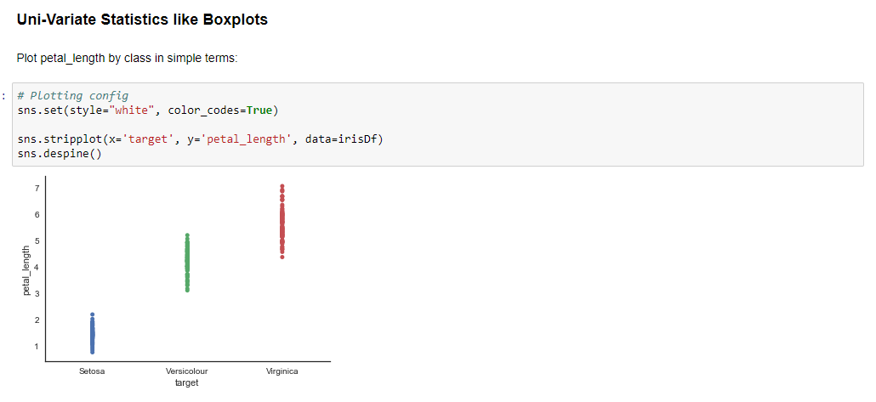
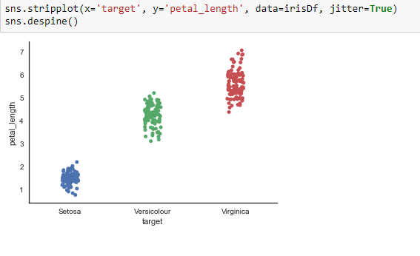
Code Review

Slide 47
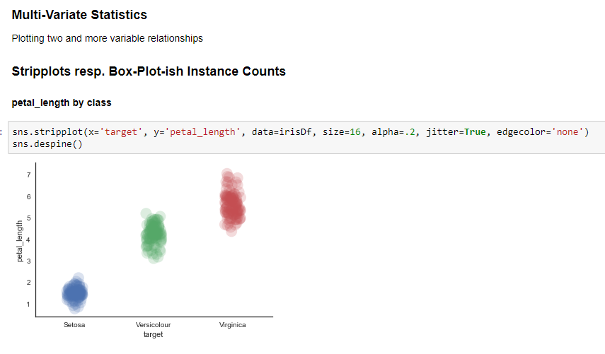
Code Review

Slide 48
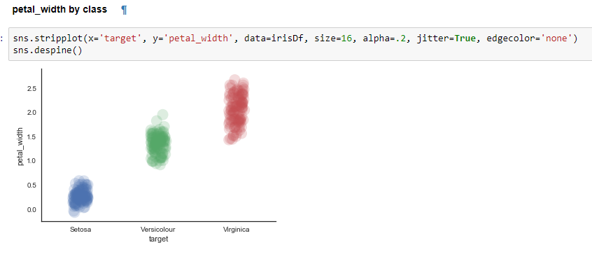
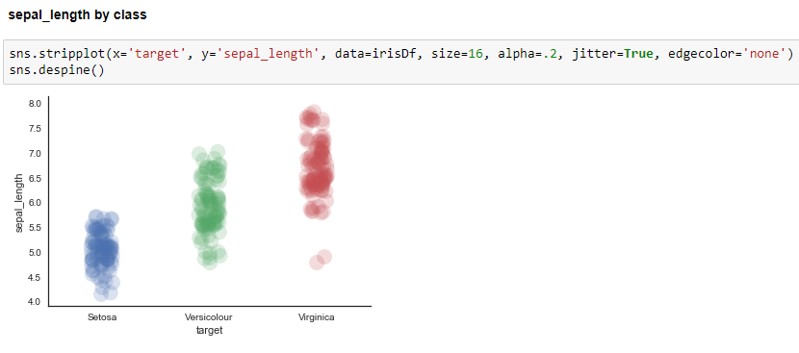
Code Review
The information contained in this document is proprietary. Copyright © 2018 Capgemini. All rights reserved.

Slide 49
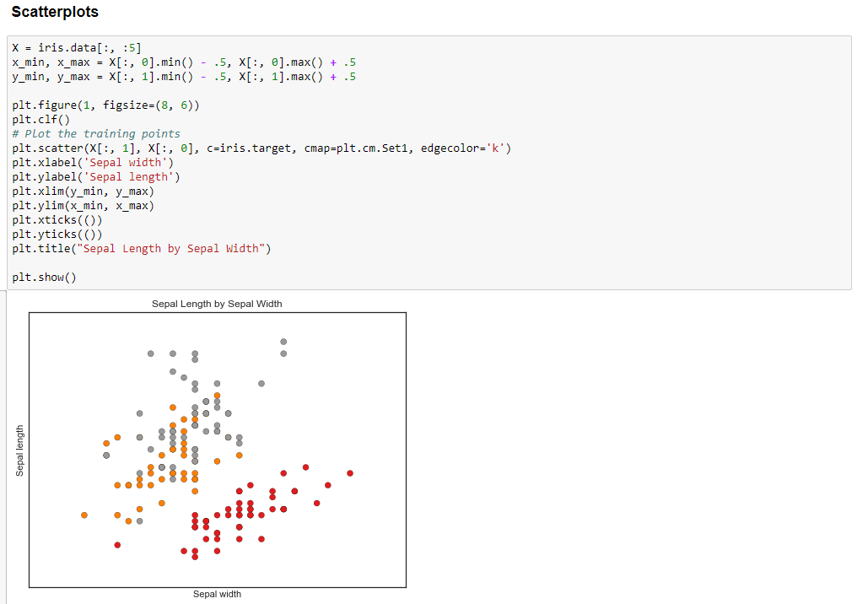
Code Review

Slide 50
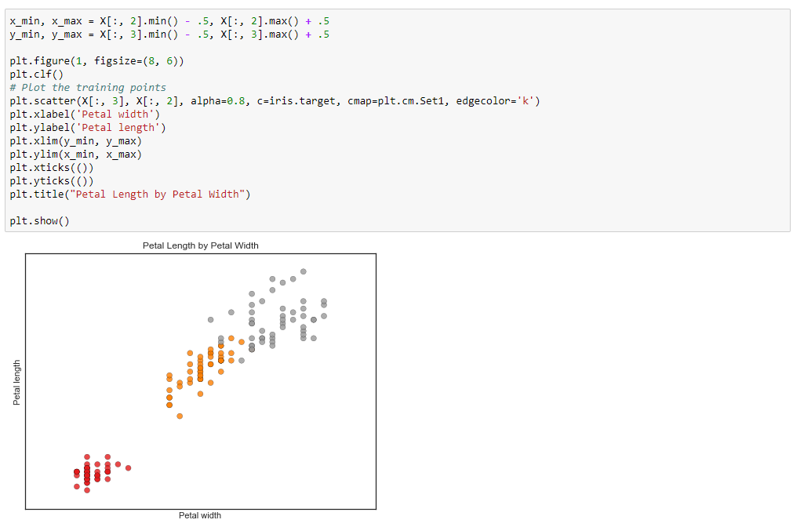
Code Review

Slide 51
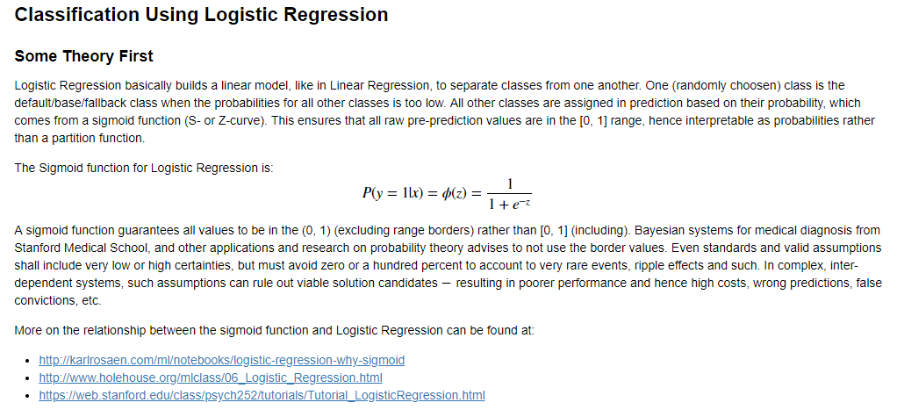
Code Review

Slide 52
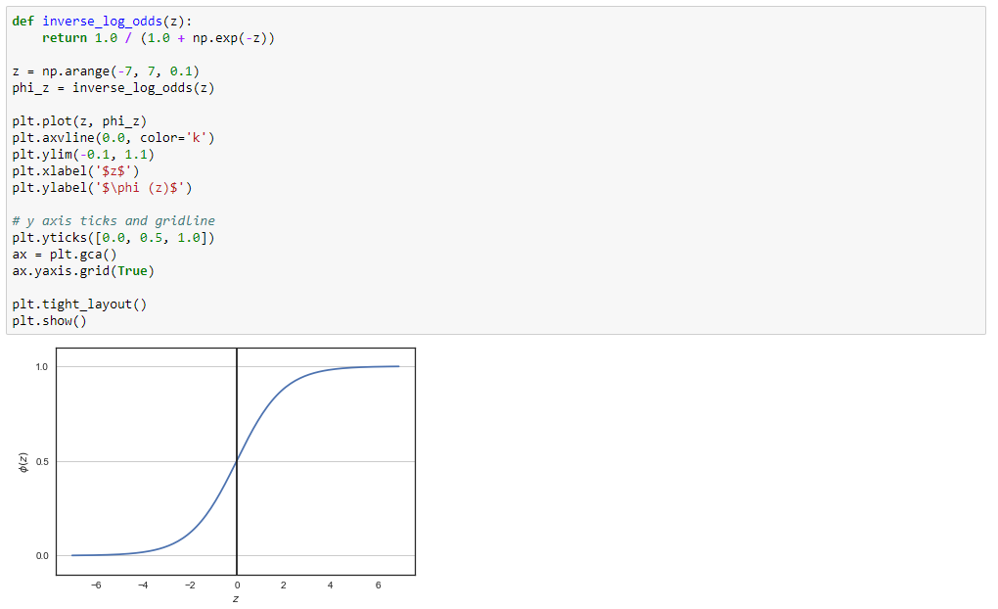
Code Review

Slide 53
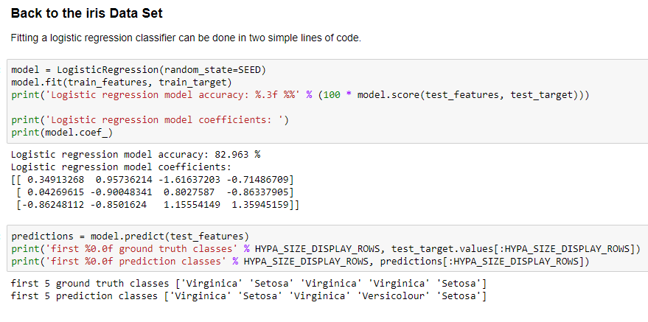
Code Review

Slide 54
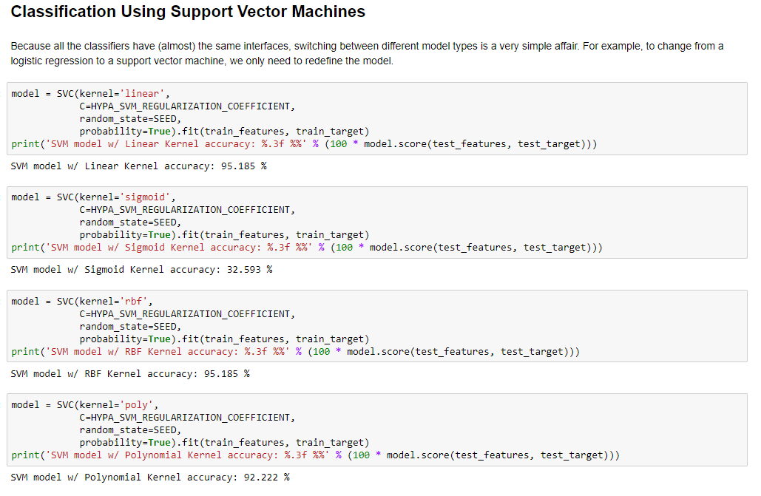
Code Review

Slide 55
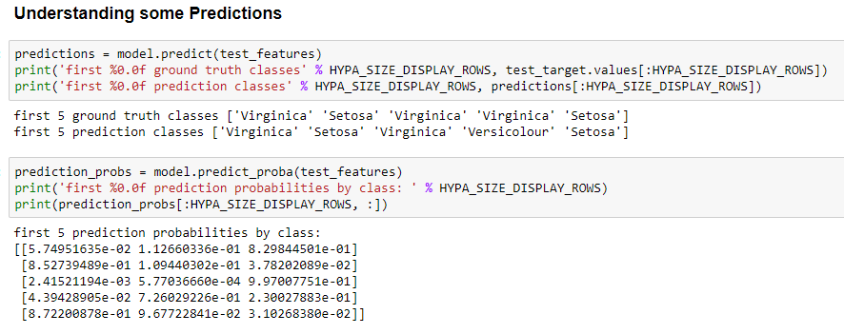
Code Review

Slide 56
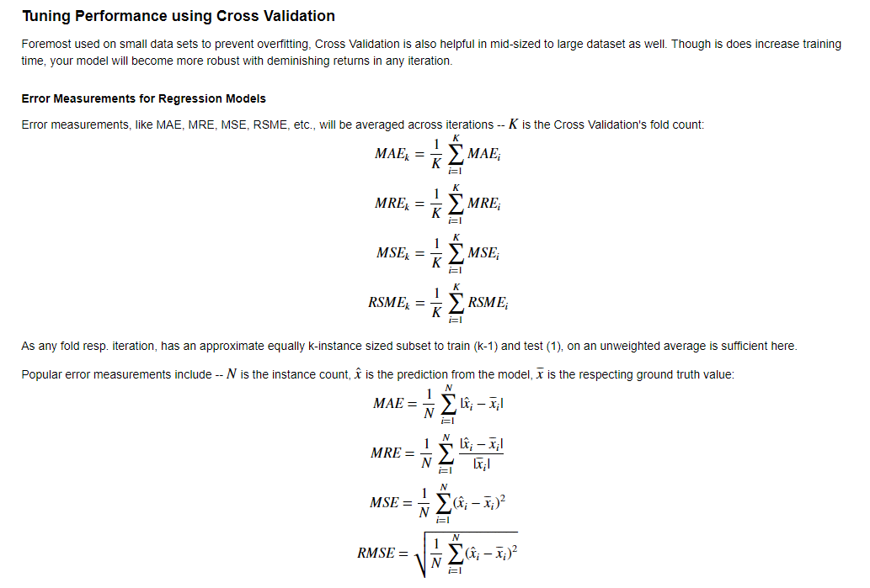
Code Review
The information contained in this document is proprietary. Copyright © 2018 Capgemini. All rights reserved.

Slide 57
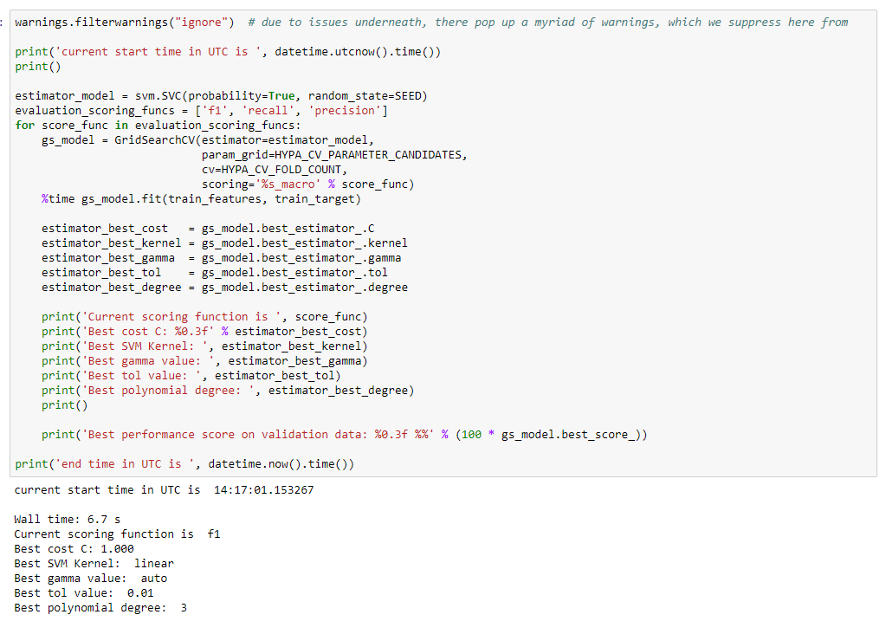
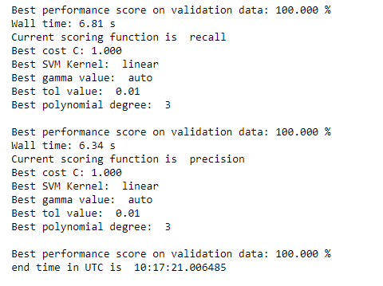
Code Review
The information contained in this document is proprietary. Copyright © 2018 Capgemini. All rights reserved.

Slide 58
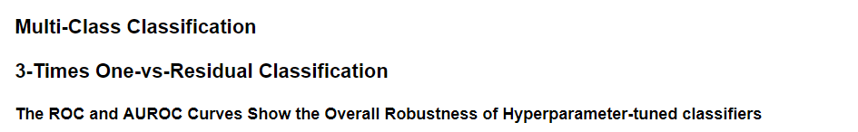
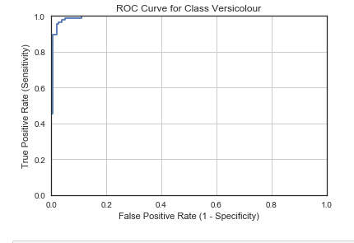
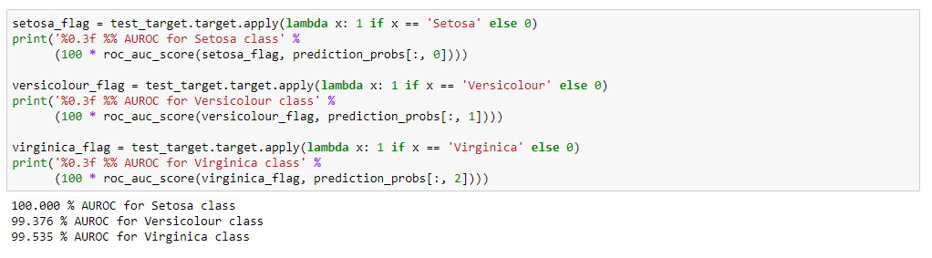
Code Review

Slide 59
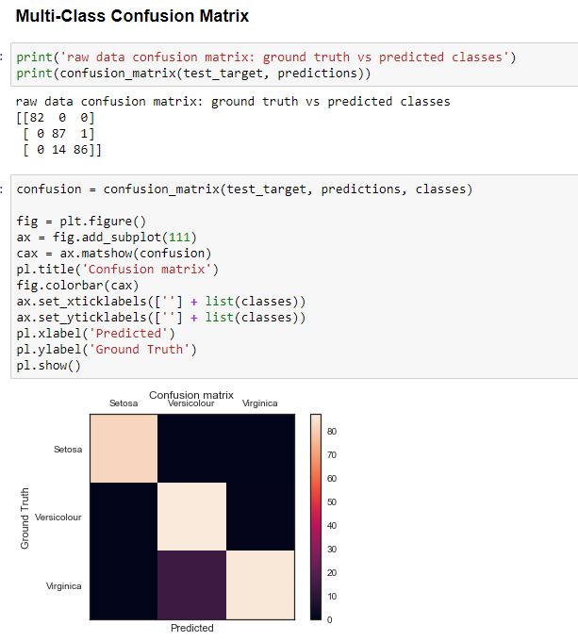
Code Review

Slide 60
Chapter 9: Decision Trees and
Random Forest

Slide 61
Chapter 9: Decision Trees and Random Forests Decision Trees

Slide 62
Distinguishing Bears, Hawks, Penguins, and Dolphins
Has feathers?
True
False
Can fly?
Has fins?
True
False
True
False
Hawk
Penguin
Dolphin
Bear

Slide 63

Definition of Decision Trees
Decision Trees are versatile Machine Learning algorithms that can perform both classification and regression tasks, and even multioutput tasks. They are very powerful algorithms, capable of fitting complex datasets.
Essentially, decision trees learn a hierarchy of “if-else” questions, leading to a decision.
→ Your goal is to get to the right answer by asking as few if-else questions as possible.

Slide 64
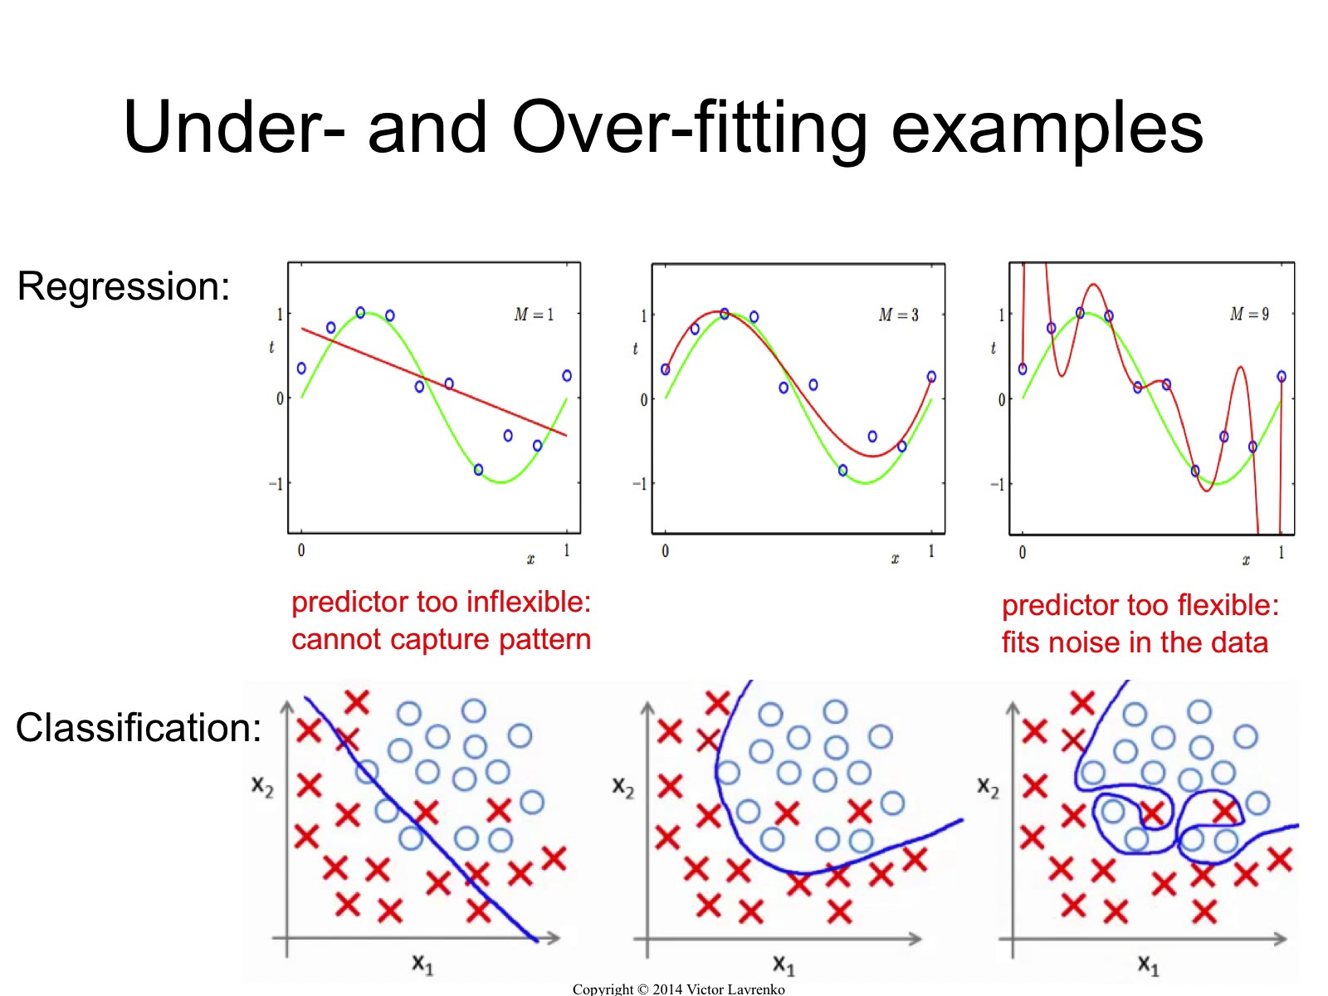
Adaptibility of Decision Trees
Regression
Classification

Slide 65

Decision Trees Easily Overfit
Decision Trees make very few assumptions about the training data (as opposed to linear models, which obviously assume that the data is linear, for example).
If left unconstrained, the tree structure will adapt itself to the training data, fitting it very closely, and most likely overfitting it.
Such a model is often called a nonparametric model, not because it does not have any parameters (it often has a lot) but because the number of parameters is not determined prior to training, so the model structure is free to stick closely to the data.
In contrast, a parametric model such as a linear model has a predetermined number of parameters, so its degree of freedom is limited, reducing the risk of overfitting (but increasing the risk of underfitting).

Slide 66

Decision Trees Are Easy to Interpret
Model interpretation: white box versus black box
Decision Trees are fairly intuitive and their decisions are easy to interpret. Such models are often called white box models.
In contrast, as we will see, Random Forests or neural networks are generally considered black box models. They make great predictions, and you can easily check the calculations that they performed to make these predictions; nevertheless, it is usually hard to explain in simple terms why the predictions were made.
Decision Trees are great if understanding the model is a must

Slide 67
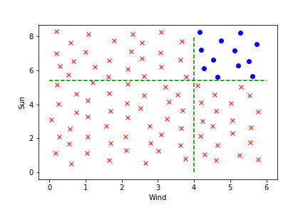
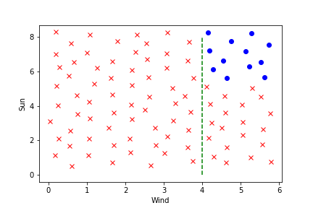
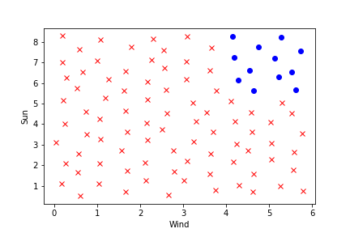
How to Train a Decision Tree
A basic example: Imagine you want to do windsurfing. You need sun and you need wind.
Can you find axis-parallel lines that separate the data best?
Parallel to y-axis:
Parallel to x-axis:
→ Consequently windsurfing makes sense if the unit for wind is greater than 4 and the unit for sun greater than 5.5.

Slide 68
How to Train a Decision Tree: Finding Splits
Classification
Divide the set of possible values for X₁, X₂, … , X_{p} into J distinct and non-overlapping regions R₁, R₂, … , R_{J}.
For every observation that falls into region R_{i}, we make the same prediction which is the majority of the response values for the training observations in R_{i.}
Note that Decision Tress are greedy: At each step of the tree-building process the best split is made at that particular step, rather than looking ahead and picking a split that will lead to a better tree in some future step.

Slide 69

Which Split Position is the Best?
What to optimize?
Let $p_{mk}$ be the proportion of training observations in the m-th region that are from the k-th class.
Gini index: $G=\sum_{k=1}^{K}{p_{mk}(1−p_{mk})}$ is a measure of total variance across the K classes.
Cross-entropy: $D=−\sum_{k=1}^{K}{p_{mk} }\log{p_{mk}}$
Note both G and D are near zero if $p_{mk}$ is either near zero or near one.
G and D evaluate the quality of a particular split. Choose the next split in such a way that G or D changes the most.

Slide 70
When to use Decision Trees
+ | -
Trees are very easy to explain to people. | Constrained trees generally do not have the same level of predictive accuracy as some of the other regression and classification approaches.
Trees can easily handle qualitative predictors without the need to create dummy variables. | Trees can be very non-robust. In other words, a small change in the data can cause a large change in the final estimated tree.
Trees can be displayed graphically, and are easily interpreted even by a non-expert (especially if they are small).

Slide 71

A Small Example
How to implement it:

Slide 72
Some Important Parameters
Parameter | Description
max_depth | Determines how many branches are allowed. Too many of them will result in overfitting
min_samples_split | Controls the number of samples in a leaf node
min_impurity_decrease | A node will only be split, if split induces a decrease of impurity >= this value

Slide 73

How to Visualize Decision Trees
clf is a decision tree classifier

Slide 74

Let’s Visualize a DT for the Iris Reduced Dataset

Slide 75

Graphic Visualizes Decision Trees

Slide 76
Chapter 9: Decision Trees and Random Forests Random Forests

Slide 77

Which Split Position is the Best?
What to optimize?
Let $p_{mk}$ be the proportion of training observations in the m-th region that are from the k-th class.
Gini index: $G=\sum_{k=1}^{K}{p_{mk}(1−p_{mk})}$ is a measure of total variance across the K classes.
Cross-entropy: $D=−\sum_{k=1}^{K}{p_{mk} }\log{p_{mk}}$
Note both G and D are near zero if $p_{mk}$ is either near zero or near one.
G and D evaluate the quality of a particular split. Choose the next split in such a way that G or D changes the most. ar

Slide 78
Ensemble Learning
Suppose you ask a complex question to thousands of random people, then aggregate their answers. In many cases you will find that this aggregated answer is better than an expert’s answer.
This is called the wisdom of the crowd.
Similarly, if you aggregate the predictions of a group of predictors (such as classifiers or regressors), you will often get better predictions than with the best individual predictor.
A group of predictors is called an ensemble; thus, this technique is called Ensemble Learning, and an Ensemble Learning algorithm is called an Ensemble method.

Slide 79
Random Forests: Ensemble of Decision Trees
A Random Forest consists of a group of Decision Tree classifiers, each on a different random subset of the training set.
Every tree uses (slightly) different training data. Data is sampled with replacement from the original data.
In every node, only a small set of features is available for the next split.
To make predictions, you just obtain the predictions of all individual trees, then predict the class that gets the most votes.
Random Forests are one of the most powerful and popular algorithm!

Slide 80

Random Forests are Part of Sklearn

Slide 81

Variable Importance for Random Forests
One disadvantage of Random Forests is that they are not as easily interpretable as Decision Trees.
However we can calculate a measure for the overall importance of each predictor: Sum up the total amount that the Gini index is decreased by splits of a given predictor and divide this number be the total number of trees.

Slide 82

How to Plot the Feature Importance
Let the Random Forest classifier be rf

Slide 83
Classifier (Algorithm) vs. Regression (Data Model)
Binary
Classifier
Multi-class Classifier
Regression Assumptions

Slide 84

Random Forests
Explanation of the two steps:
Say we have n trees in our forest and every single tree has variance ${\text{σ}}^{2}$. High variance means overfitting. It would be better to have a variance of $\frac{{\text{σ}}^{2}}{n}$ instead. But for that purpose the data must be uncorrelated.
Sampling with replacement helps a lot
Imagine we use all predictors in every single node. Most likely some predictors are stronger than others. In such a situation the next split would always be done using this strong predictor. As a consequence most resulting trees are still very high correlated. Allowing only a relatively small amount of predictors at each node yields a forest with fairly uncorrelated trees.
Only use $\sqrt{p}$ of the p predictors at each node

Slide 85

The Most Important Parameters
Some important parameters:
max_features The number of features to consider when looking for the best split. (Default: $\sqrt{n_features}$
n_jobs Number of jobs to run in parallel for both fit and predict. Choose -1 for setting to the numbers of cores. Don’t exceed the number of your PC’s physical cores. (Default: 1)
bootstrap Whether bootstrap samples are used when building trees. (Default: True)

Slide 86
Chapter 10: Code Overview
Jupyter Notebook

Slide 87

Decision Trees

Slide 88

Decision Trees

Slide 89



Decision Trees

Slide 90



Random Forests

Slide 91

Random Forests

Slide 92
Next Week’s
Session
Unsupervised Learning – Clustering and PCA
In this workshop you will learn:
The other family of Machine Learning Algorithms: Unsupervised Learning
Clustering and dimensionality reduction

Slide 93
- End of Presentation -
Thank you

